Slide 1
Strategic Marketing Simulator 1.0 Sprint 5 review
Strategic Marketing Simulator 1.0
Team # 15
Team Members
Javier Andrial
Jeffrey Carman
Product Owner: Joseph Cilli
Project Mentor: Masoud Sadjadi

Slide 2
Disclaimer
Uneven work load

Slide 3
User Stories
#816 Account Management page
Description:
From this page, a User will be able to change their password, change their secret question, and change their secret answer.
This page will also display some information about their account, such as email, name, and panther id if available.
Acceptance Criteria:
User is logged into the System
Tasks
Display relevant account information
Get the users information from the database
Add a feature to update the password of the current user in the Database
Add a feature to update recovery question and a recovery answer.
User must provide the current password for their account before changing their password or updating their recovery question and answer.

Slide 4
User Stories
#822 Sign out
Description:
End the users session, logging them out the System.
Acceptance Criteria:
User is logged into the System
Tasks
Ends the users session(s)
Display users email before logging them out

Slide 5
Goals
#816 Account Management page
The goal of this page is to provide the user information about their account as well as provide functionality to change their account’s password and recovery question and answer
#822 Sign out
The goal of this page is to provide a safe way of leaving the System.

Slide 6
Functional Requirements
#816 Account Management page
Function requirements
User must be able to change their password
User must be able to Change their secret answer and question
User must be logged into the system to be to use Account Management
User must enter in their current password to be able to change their password, secret question, and secret answer
Non function requirements
Simple
Appearance coheres to the style of the website

Slide 7
Functional Requirements
#822 Sign out
Function requirements
Clears users session
Non function requirements
Conveys clear understanding that their account has been logged off

Slide 8
Scenarios
#816 Account Management page
Scenario 24 – Account Management - User Changes their Password
Student Phil, is logged into the System. Phil decided the password he choose for the System during account creation is not secure enough. Phil, from any page, selects the ‘My Account’ link. Phil then selects, “Change my password” button, enters in his current password and his new password and finishes by presses, “Change password”.
Scenario 25 – Account Management - User Changes their Secret Question and Answer
Student Phil, is logged into the System. Phil, decided that the secret question and secret answer he choose during account creation is not secure enough. Phil, from any page, selects the ‘My Account’ link. Phil then selects, “Change my Recovery Question/Ans” button, enters in his current password, his new secret Question, and secret answer for his secret question. Phil, finishes by presses, “Change my recovery question/ans”.

Slide 9
Use Cases
Use Case 24 - Account Management - User Changes their Password
Actor:
Student
Admin
Pre-Conditions:
Is logged into the System
Normal Course:
Actor selects the 'My Account' link on their toolbar
Actor selects ‘Change My Password’
Actor enters in their current password
Actor enters in their new current password
Actor presses ‘Change Password’ button
Alternative Course
If Actor does not enter in their correct password in Step 3
Actor will have to repeat Step 3 until the current password is entered
If Actor does not enter in a valid password in Step 4
Actor will have to repeat Step 3 until a valid password is entered in Step 4
Post-Condition
Current password has been updated
The Actors account has new account password
Current password was not changed
The Actors was unsuccessful in changing their account password

Slide 10
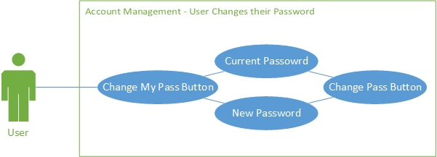

Slide 11
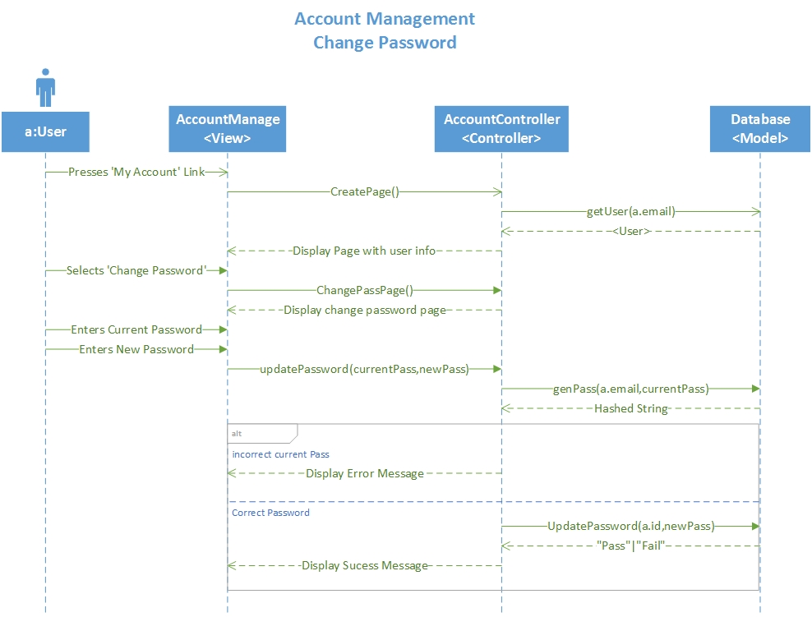
Sequence Diagrams

Slide 12
Use Cases
Use Case 25 - Account Management - User Changes their Secret Question and Answer
Actor:
Student
Admin
Pre conditions:
Is logged into the System
Is viewing a news article for a game
Normal Course
Actor selects the 'My Account' link on their toolbar
Actor selects ‘Change My Recovery Question’
Actor enters in their current password
Actor enters in their new secret question
Actor enters in their new secret answer
Actor presses ‘Change Password’ button
Alternative Course
If Actor does not enter in their correct password in Step 3
Actor will have to repeat Step 3 until the current password is entered
If Actor does not enter in a valid secret question in Step 4
Actor will have to repeat Step 3 until a valid secret question is entered in Step 4
If Actor does not enter in a valid secret answer in Step 5
Actor will have to repeat Step 3 until a valid secret answer is entered in Step 5
Post-Condition
Current secret question and answer has been updated
The Actors account has new account password
Current secret question and answer was not changed
The Actors was unsuccessful in changing their secret question and answer

Slide 13
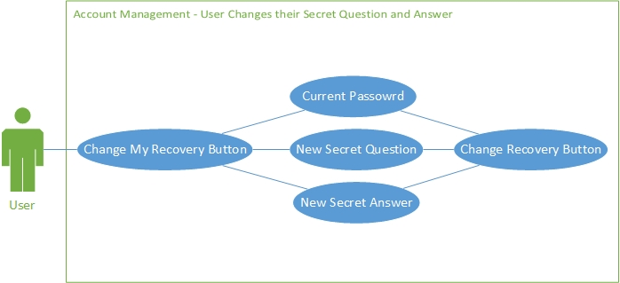

Slide 14
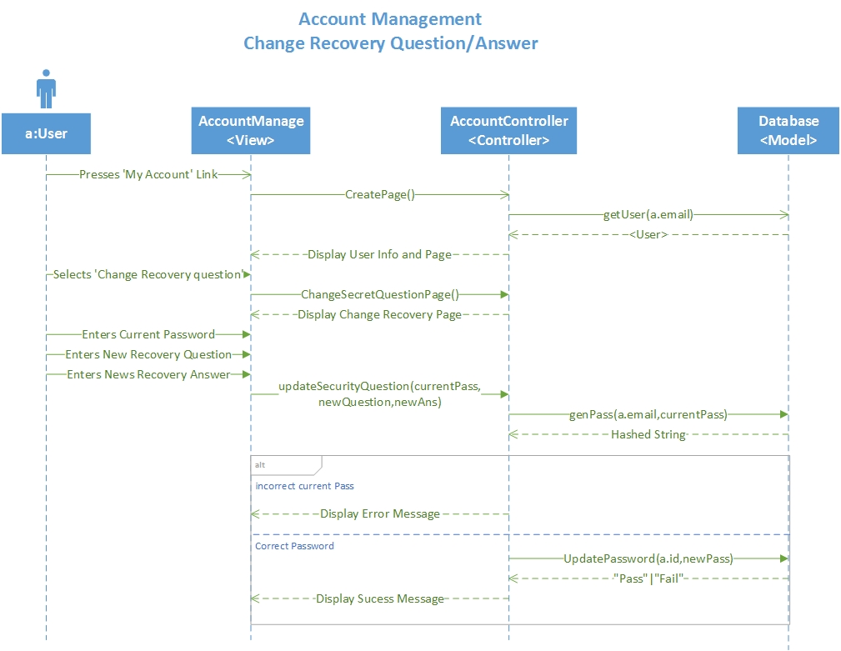
Sequence Diagrams

Slide 15
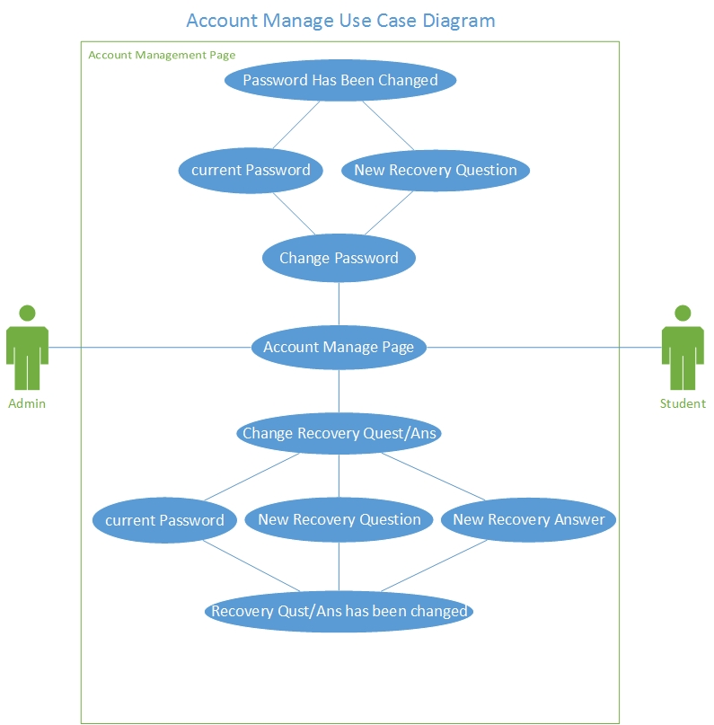

Slide 16
Scenario
#822 Sign out
Scenario 27 – User logs off
Phil, has completed his task on the System and wishes to log his account out so his partner Tracy can log into the System and perform her accounts on the System. From any page, Phil, presses the ‘Sign Out’ link on the toolbar. A message is displayed that Phil’s email, Phil018@fiu.edu has been logged off. Tracy, now gets on the computer, presses the ‘Log in’ link on the same page.

Slide 17
Use Cases
Use Case 27 - User Logs Off
Actor:
Student
Admin
Pre conditions:
Is logged into the System
Normal Course
1. Actor selects the 'Sign Out' link on their toolbar
2. Actors account has now been logged out of the System
Post-Condition
Actor was successfully logged out
The Actors session has been cleared

Slide 18
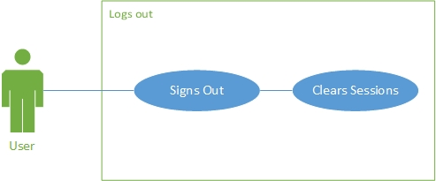

Slide 19
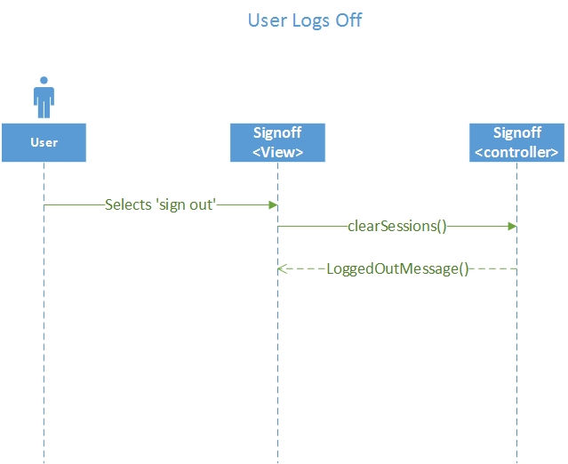
Sequence Diagrams

Slide 20
Live Demonstration
View account details
Change password
Change recovery question
Change recovery answer
Sign out

Slide 21
Software Testing
PHPUnit 4.8.9 by Sebastian Bergmann and contributors. Runtime: PHP 5.5.9-1ubuntu4.11Configuration: /srv/marketsim/www/Tests/phpunit.xml
AccountController
ok - AccountControllerTest::test__constructInvalidPar
ok - AccountControllerTest ::test__construcValidPar
ok - AccountControllerTest ::test_CreatePage
ok - AccountControllerTest ::test_UserInfoPage
ok - AccountControllerTest ::test_getUserInfo
ok - AccountControllerTest ::test_changePasswordPage
ok - AccountControllerTest ::test_changeRecoveryPage
ok - AccountControllerTest ::test_updateRecovery
ok - AccountControllerTest ::test_updatePassword
Database
ok - databaseTest::test_updateStudentQuestion
ok - databaseTest::test_updateAdminQuestion
ok - databaseTest::test_updateStudentAnswer
ok - databaseTest::test_updateAdminAnswer
ok - databaseTest::test_updateStudentPassword_by_id
ok - databaseTest::test_updateAdminPassword_by_id

Slide 22
Test Case
Test ID: | AccountControllerUserInfoPageTest62
Description: | Test database function UserInfoPage with valid input
Test Steps | Step 1: Create AccountController object $a
 | Step 2: $result ="<h3>My Account</h3><br /><br />". "<div class='table-responsive'>". "<table class='table table-bordered'>"."<tbody>". "<tr>"."<td>"."<strong>Role: </strong>"."</td>". "<td>".($user['isAdmin']?"Admin":"Student")."</td>". "</tr>"."<tr>"."<td>"."<strong>PID: </strong>"."</td>". "<td>".$user['id']."</td>"."</tr>"."<tr>"."<td>"."<strong>Name: </strong>"."</td>". "<td>".$user['fname']." ".$user['lname']."</td>". "</tr>"."<tr>"."<td>"."<strong>Email: </strong>"."</td>". "<td>".$user['email']."</td>"."</tr>"."<tr>". "<td>"."<strong>Recovery Question: </strong>"."</td>". "<td>".$user['secQuestion']."</td>". "</tr>"."</tbody></table>"."</div>"; . "<br />"."<br />"."<br />"."<a href='http://marketsim-dev.cis.fiu.edu/Account%20Manage/accountManage.php?button_ChangeMyRecovery=Change+My+Recovery+Quest%2FAns' class='btn btn-primary'>Change My Recovery Quest/Ans</a>"." "."<a href='http://marketsim-dev.cis.fiu.edu/Account%20Manage/accountManage.php?button_ChangeMyPassword=Change+My+Password' class='btn btn-primary'>Change My Password</a>";”
 | Step 3: assertEquals($a->UserInfoPage(), $result)
Tester: | Javier Andrial
Result: | Pass

Slide 23
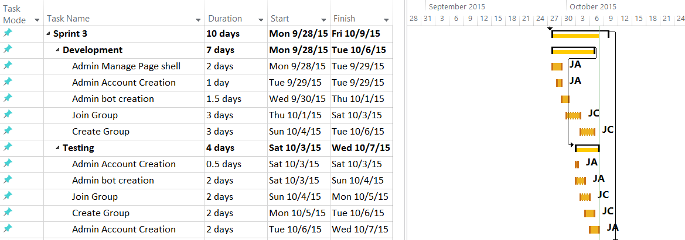
Sprint Schedule

Slide 24
Strategic Marketing Simulator 1.0
Questions?

